Slide 1
Quantum error correction

Slide 2
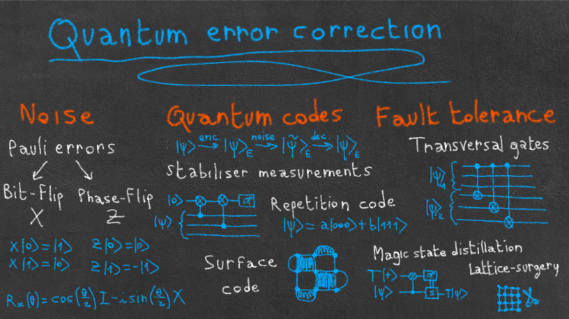

Slide 3
decoherence
In quantum computing, the basic unit is the qubit. Regardless of the physical medium used (superconducting circuits, trapped ions, neutral atoms, photons, etc.), the qubit remains extremely fragile.
It is very sensitive to its environment: even the slightest interaction with it causes a rapid loss of quantum coherence.
This is the phenomenon of decoherence.
To perform useful quantum computations on a large scale, it is therefore essential to detect and correct these errors in real time.

Slide 4
Why Decoherence Happens
Quantum states are fragile. If a qubit interacts with anything outside (air molecules, photons, vibrations, temperature, noise), the environment “measures’’ the qubit accidentally.
This causes the off-diagonal elements of the density matrix to vanish.

Slide 5
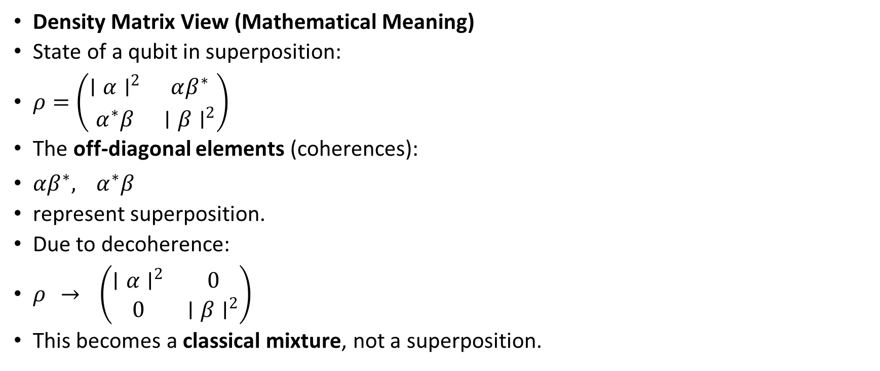
Density Matrix View (Mathematical Meaning)
State of a qubit in superposition:
$ρ=\left(\begin{matrix}∣α∣^{2} & αβ^{∗} \\ α^{∗}β & ∣β∣^{2}\end{matrix}\right)$
The off-diagonal elements (coherences):
$αβ^{∗}, α^{∗}β$
represent superposition.
Due to decoherence:
$ρ → \left(\begin{matrix}∣α∣^{2} & 0 \\ 0 & ∣β∣^{2}\end{matrix}\right)$
This becomes a classical mixture, not a superposition.

Slide 6
Two Main Types of Decoherence
1️⃣ T₁ – Relaxation (Energy Loss)
The qubit “relaxes” from |1⟩ → |0⟩.
Usually caused by:
photon emission
thermal noise
vibration
This destroys stored energy.
2️⃣ T₂ – Dephasing (Loss of Phase Information)
The relative phase between |0⟩ and |1⟩ gets scrambled.
Superposition loses its phase, so interference disappears.
Most common cause:
fluctuations in magnetic/electric field
crosstalk
imperfect isolation
❗ Even if the qubit stays in |0⟩ or |1⟩, its phase disappears, and the quantum advantage is gone.

Slide 7
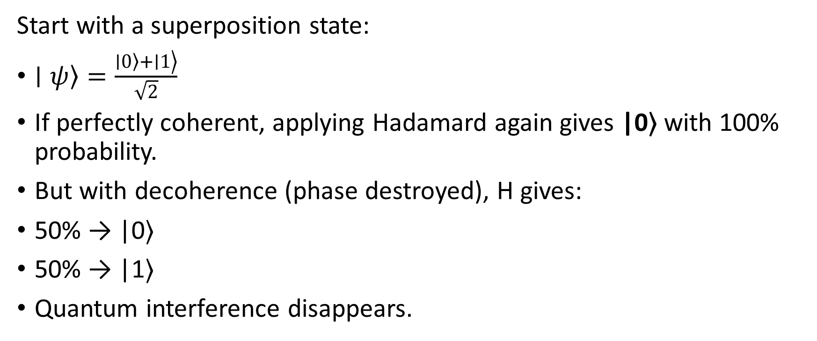
Start with a superposition state:
$\left.∣ψ\right\rangle =\frac{\left.\left.∣0\right\rangle +∣1\right\rangle }{\sqrt{2}}$
If perfectly coherent, applying Hadamard again gives |0⟩ with 100% probability.
But with decoherence (phase destroyed), H gives:
50% → |0⟩
50% → |1⟩
Quantum interference disappears.

Slide 8
What Is Quantum Error Correction (QEC)?
Quantum Error Correction is a technique that protects fragile quantum states from noise, decoherence, and operational errors — without ever measuring or destroying the qubit’s quantum information.
Because:
You cannot copy a qubit (No-Cloning Theorem).
You cannot directly measure a qubit without collapsing it.
Qubits decay (T₁), lose phase (T₂), and gates introduce errors.
So QEC spreads the information of 1 logical qubit across many physical qubits, and uses syndrome measurements to detect and correct errors without reading the actual state.

Slide 9
Why Do We Need QEC?
Every quantum computer has:
Decoherence
Gate noise
Readout errors
Crosstalk
Thermal relaxation
Dephasing
Without QEC:
❗ Quantum circuits must be extremely short ❗ Deep algorithms (like Shor, Grover, QML) become impossible ❗ Entanglement becomes unstable
With QEC:
✔ Long computations possible ✔ Logical qubits survive seconds/minutes (vs microseconds) ✔ Fault-tolerant quantum computing becomes achievable

Slide 10
Error Correction
Classical: we correct by looking + copying.
Quantum: according to the principles of quantum mechanics
looking (mesure) = collapse of wave function → prohibited.
copying = no-cloning theorem → prohibited.

Slide 11
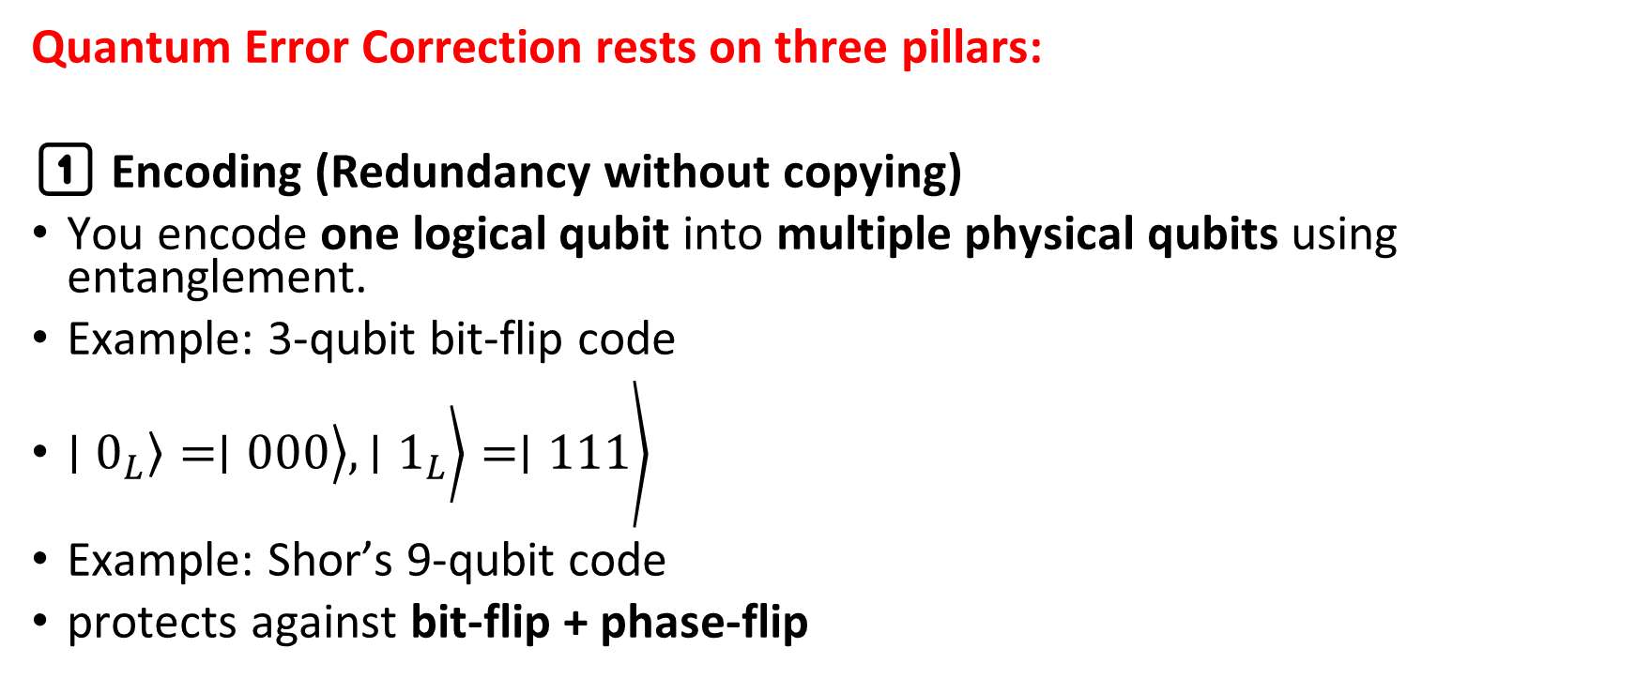
Core Concepts of Quantum Error Correction
Quantum Error Correction rests on three pillars:
1️⃣ Encoding (Redundancy without copying)
You encode one logical qubit into multiple physical qubits using entanglement.
Example: 3-qubit bit-flip code
$\left.\left.\left.\left.∣0_{L}\right\rangle =∣000\right\rangle , ∣1_{L}\right\rangle =∣111\right\rangle$
Example: Shor’s 9-qubit code
protects against bit-flip + phase-flip

Slide 12
QEC
2️⃣ Syndrome Measurement (Detect errors without collapsing)
We measure ancilla (helper) qubits in such a way that:
The error is detected
The quantum state (superposition) is not measured
Syndrome bits show which qubit is wrong, not what the state is.
3️⃣ Recovery (Correct the error)
Based on syndrome values, apply:
X correction → fixes bit flip
Z correction → fixes phase flip
Y correction → bit + phase
The logical state is restored.

Slide 13
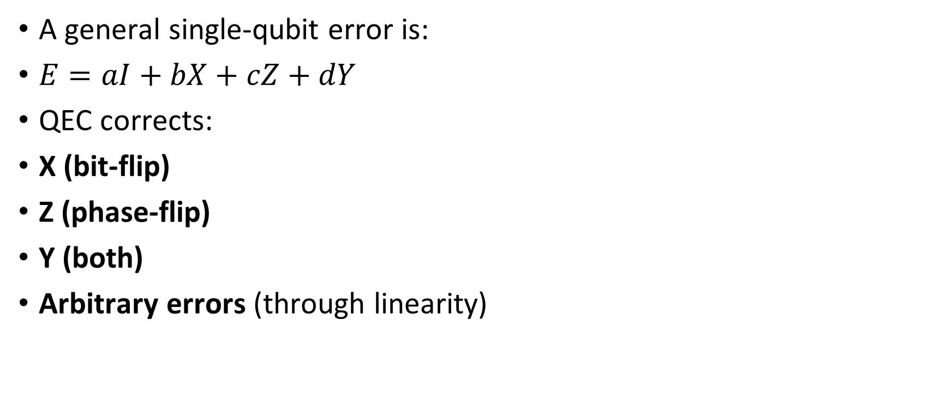
Types of Quantum Errors Handled
A general single-qubit error is:
$E=aI+bX+cZ+dY$
QEC corrects:
X (bit-flip)
Z (phase-flip)
Y (both)
Arbitrary errors (through linearity)

Slide 14
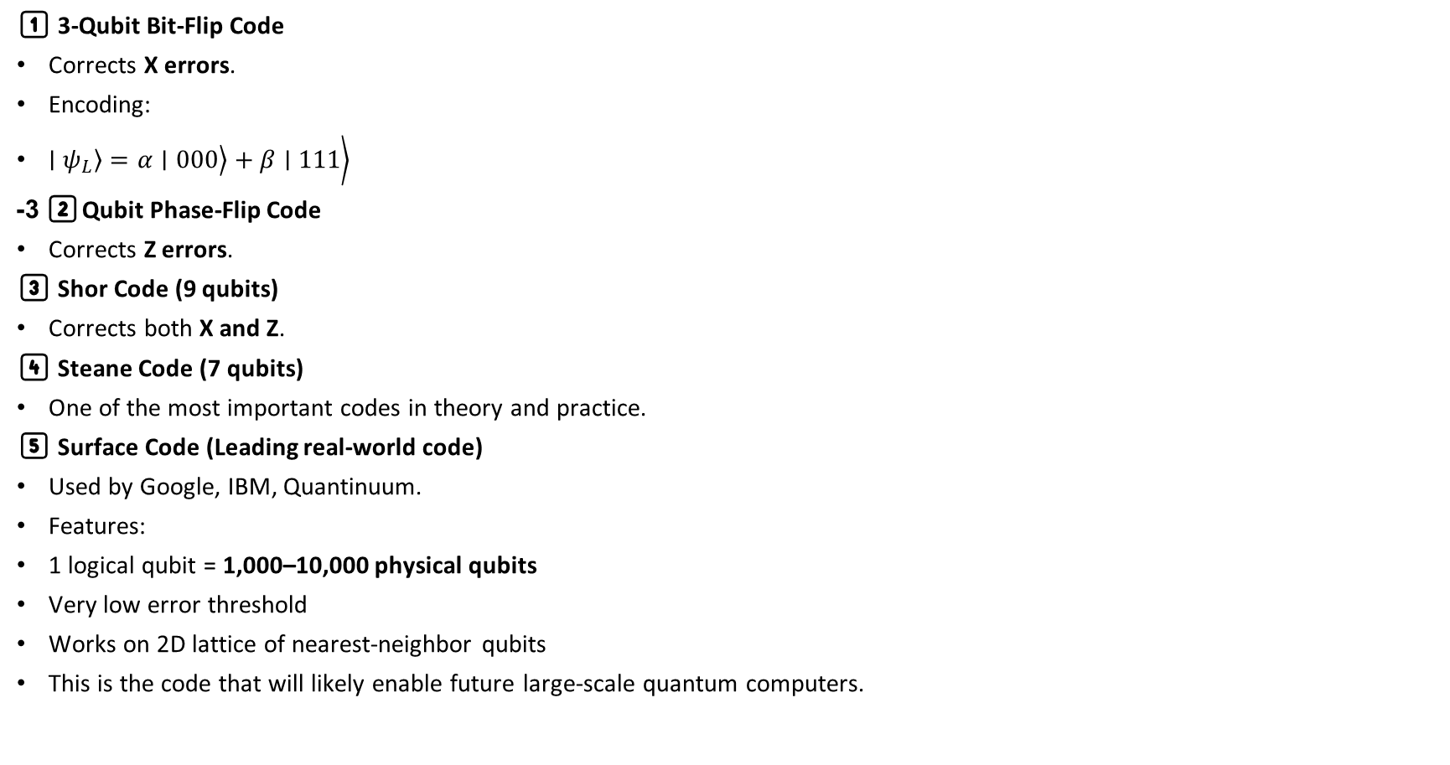
🏗️ Most Important QEC Codes
1️⃣ 3-Qubit Bit-Flip Code
Corrects X errors.
Encoding:
$\left.\left.\left.∣ψ_{L}\right\rangle =α∣000\right\rangle +β∣111\right\rangle$
2️⃣ 3-Qubit Phase-Flip Code
Corrects Z errors.
3️⃣ Shor Code (9 qubits)
Corrects both X and Z.
4️⃣ Steane Code (7 qubits)
One of the most important codes in theory and practice.
5️⃣ Surface Code (Leading real-world code)
Used by Google, IBM, Quantinuum.
Features:
1 logical qubit = 1,000–10,000 physical qubits
Very low error threshold
Works on 2D lattice of nearest-neighbor qubits
This is the code that will likely enable future large-scale quantum computers.

Slide 15
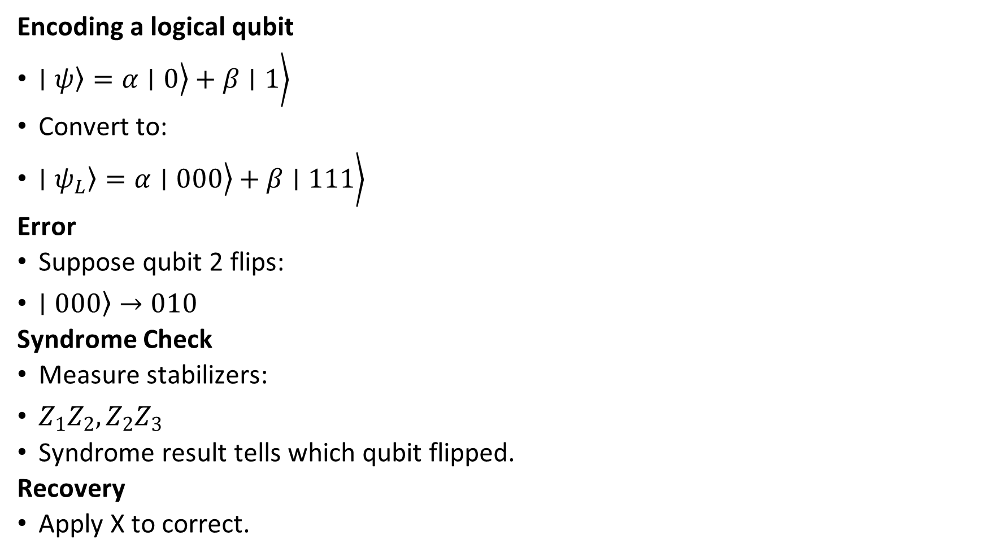
Example: Bit-Flip Code (Simple Demonstration)
Encoding a logical qubit
$\left.\left.\left.∣ψ\right\rangle =α∣0\right\rangle +β∣1\right\rangle$
Convert to:
$\left.\left.\left.∣ψ_{L}\right\rangle =α∣000\right\rangle +β∣111\right\rangle$
Error
Suppose qubit 2 flips:
$\left.∣000\right\rangle →010$
Syndrome Check
Measure stabilizers:
$Z_{1}Z_{2}, Z_{2}Z_{3}$
Syndrome result tells which qubit flipped.
Recovery
Apply X to correct.

